Slide 1
Paper 8 Open Challenges for Data Stream Mining Research
-By
Sowmya Yelmati(32)
Mohamed Gharibi(7)

Slide 2
Introduction
Volumes of automatically generated data are constantly increasing.
According to Digital Universe Study over 2.8ZB of data were created and processed in 2012, with a projected increase of 15 times by 2020.
A significant part of such data is volatile.
Data Stream Mining is a research field that studies methods and algorithms for extracting knowledge from volatile streaming data.
This paper identifies real-world challenges for data stream research that are important but yet unsolved.
This paper present eight challenges for data stream mining research

Slide 3
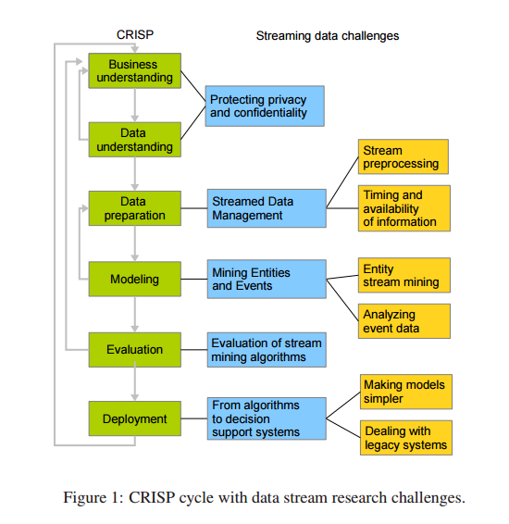
Data Stream Mining Challenges

Slide 4
Protecting Privacy And Confidentiality
The Main objective is to develop such data mining techniques that would not uncover information or patterns which compromise confidentiality and privacy obligations.
Ensuring privacy and confidentiality is important for gaining trust of the users in autonomous systems.
Two main challenges for privacy preservation in mining data streams:
Incompleteness of information.
Concept Drift.

Slide 5
Streamed Data Management
Streamed Preprocessing:
Data comes from complex environments, may be noisy, redundant, contain outliers and missing values.
Standard procedures for Preprocessing offline data is highly available and well established.
But the manual processing is not feasible for data stream as new data continuously arrives.
This research problem can be approached from several angles.
Look at the existing predictive models and integrate it with selected data preprocessing methods
Systematically characterize the existing offline preprocessing approaches and find mapping between these approaches and problem setting in data streams.

Slide 6
Streamed Data Management(Cont..)
Timing and Availability of Information:
Handling incomplete information
Dealing with skewed distributions
Handling delayed information
Active selection from costly information

Slide 7
Mining Entities and Events
Model learning in this paradigm involves the incorporation of the streaming information into the stream of entities.
Learning tasks include cluster evolution, migration of entities from one state to another.
Stream mining is a special case of entities where the occurrence of entities depends on the events.
Example:
Customers -> T
Time -> t
T linked to entity e through a foreign key relation

Slide 8
Challenges of Aggregation
how to aggregate into each entity e at each time point t the information available on it from the other streams?
What information should be stored for each entity?
How to deal with differences in the speeds of the individual streams?
How to learn over the streams efficiently?
Challenges of Learning
Changing the entity label
Entity drift
volatility

Slide 9
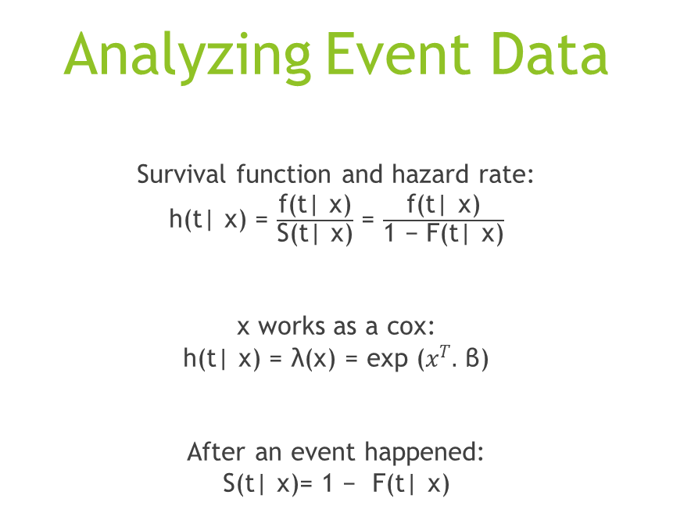
Analyzing Event Data
Survival function and hazard rate:
h(t| x) = $\frac{\text{f}\text{(}\text{t}\text{| }\text{x}\text{)}}{\text{S}\text{(}\text{t}\text{| }\text{x}\text{)}}$ = $\frac{\text{f}\text{(}\text{t}\text{| }\text{x}\text{)}}{\text{1 − }\text{F}\text{(}\text{t}\text{| }\text{x}\text{)}}$
x works as a cox:
h(t| x) = λ(x) = exp ($x^{T}.$ β)
After an event happened:
S(t| x)= 1 − F(t| x)

Slide 10
Two different settings can be envisioned on data streams:
Events are generated by multiple data sources- E-mails example (ROC algorithm).
events are produced by a single data source.
Recent machine learning problems and the main purpose:
The problem of creating complex evaluation methods

Slide 11
FROM ALGORITHMS TO DECISION SUPPORT SYSTEMS
making models simpler:
Minimizing parameter dependence
Combining offline and online models
Solving the right problem
dealing with legacy systems:
ISS Columbus
Complexity
Interlocking
Reliability and Balance

Slide 12
Thank you!
Reference :Krempl, Georg, et al. "Open challenges for data stream mining research." ACM SIGKDD Explorations Newsletter 16.1 (2014): 1-10.

